Slide 1
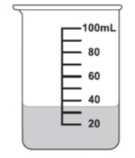

Probability Interactive Notebook
Name
Class
Teacher
Term 2 Semester 1
1

Slide 2
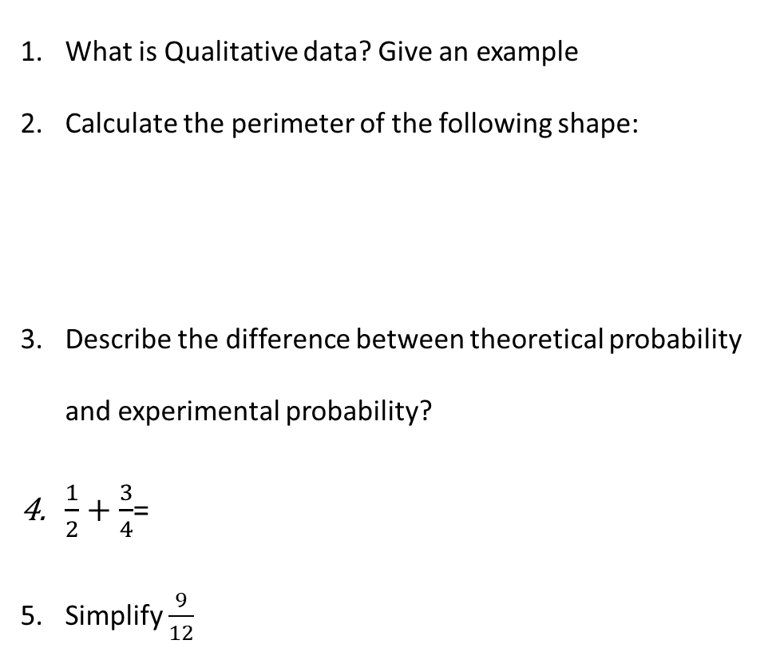
Two-Way Tables
EQ – How can obtain probabilities from a two-way table?
What is Qualitative data? Give an example
Calculate the perimeter of the following shape:
Describe the difference between theoretical probability and experimental probability?
$\frac{1}{2}+\frac{3}{4}$=
Simplify $\frac{9}{12}$
15 cm
10 cm
4 cm

Slide 3
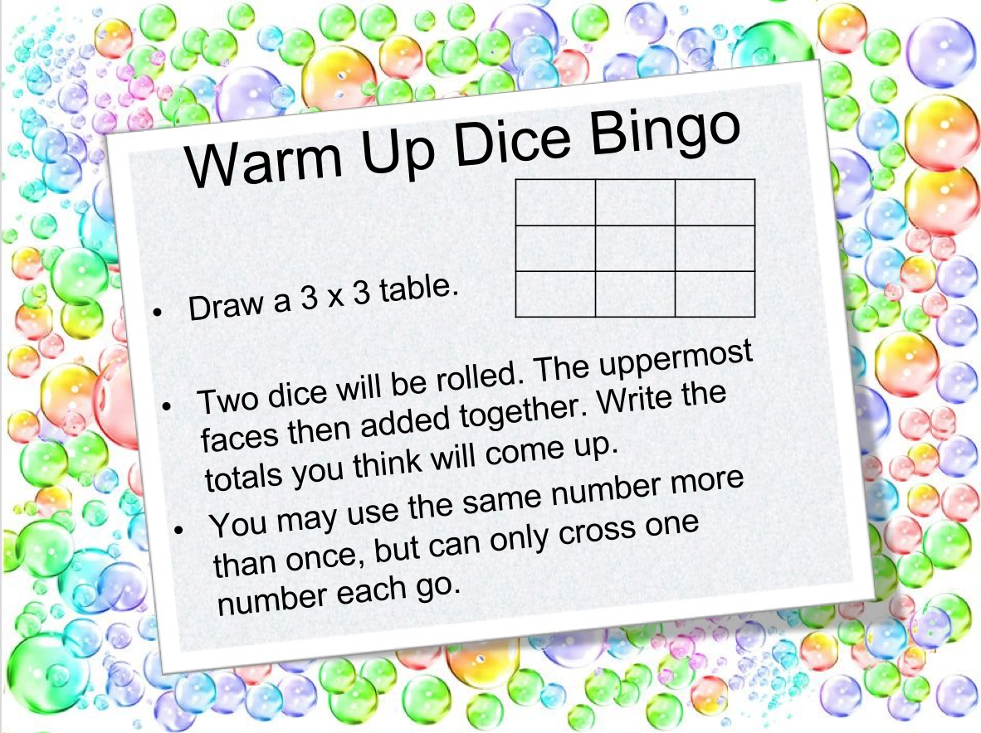

Slide 4
Consider the following
Have a think about the following questions.
Do you like football?
Do you like music?
I might be interested to find out if people liked both (or neither).
So let’s set it up like this…
 | Like M | Dislike M
Like F
Dislike F
Total
Total
This is a two-way table!!!

Slide 5
Create your own two-way table
What two question can you ask
Write these down and have room to tally your results (you should set it out in a two-way table for ease)
Ask each person in the class to survey your results.
After you have asked each person, you should present your results in a neat two-way table

Slide 6
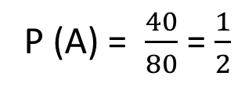
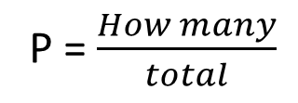
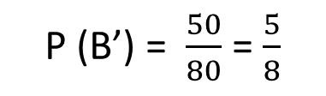
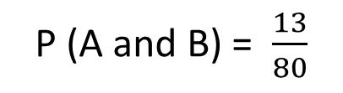
24
7
30
Date
Two-Way Tables
EQ – How can obtain probabilities from a two-way table?
What is a two-way table?
Two-way tables lists the number of outcomes (or people) in different categories, with totals at the bottom.
We display them like this.
Not A
 |  | Event A
 |  | A | A’ | Total
Event B | B
 | B’
 | Total
13
17
30
27
23
50
40
40
80
How do we find probabilities?
P = $\frac{How many}{total}$
P (A) = $\frac{40}{80}$ = $\frac{1}{2}$
P (A and B) = $\frac{13}{80}$
P (B’) = $\frac{50}{80}$ = $\frac{5}{8}$
7

Slide 7
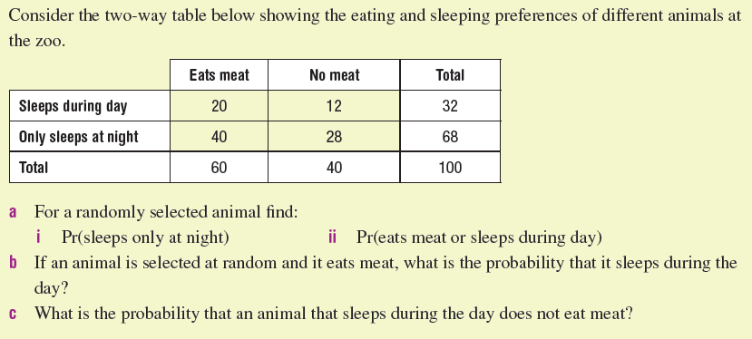
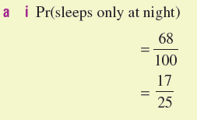
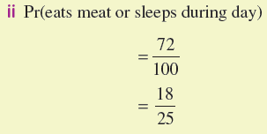
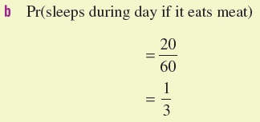

Let’s try this together

Slide 8
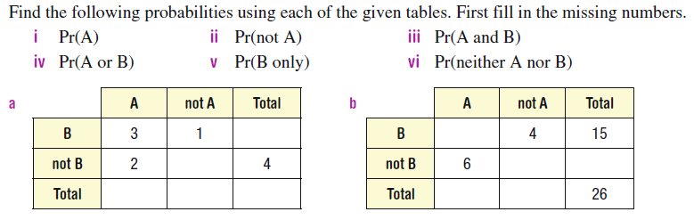
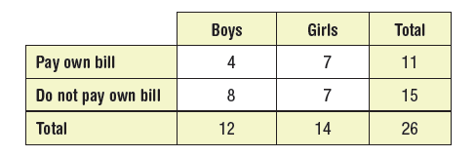
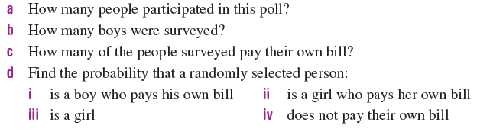
Your Turn (LHS)

